Slide 1
The Victory of Truth
Revelation 19
Notes:
His core message infuses us with purpose and passion to address the economic, environmental, military, political, and social dysfunctions that have overtaken our world

Slide 2
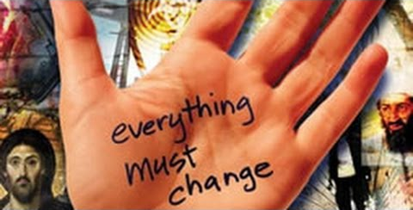
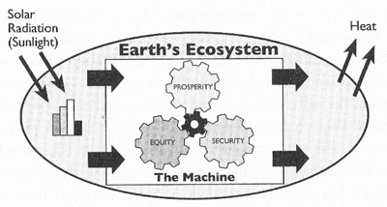
The “Amillennial View” of Revelation 20
Notes:
**MEANS → Fight “The Machine” → ~HEAT: SIN!!
**MOVIE: GLOBAL WARMING → ??SOLUTION??

Slide 3
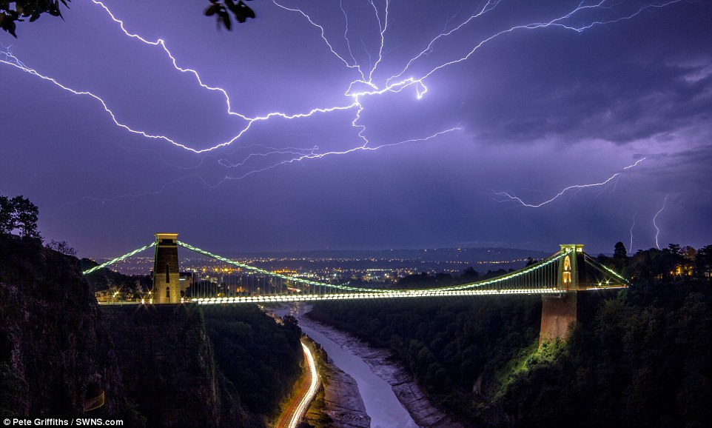
The Jesus View
Luke 17:24 For as the lightning flashes and lights up the sky from one end to the other, so it will be on the day when the Son of Man comes.
Luke 17:22-23 Then he said to his disciples, “The time is coming when you will long to see the day when the Son of Man returns, but you won’t see it. People will tell you, ‘Look, there is the Son of Man,’ or ‘Here he is,’ but don’t go out and follow them.
Notes:
JC View=RADICAL CHANGE → Lk.17 =Rips R World Apart!!
** Since JC=Many FALSE Relig: Islam= “Me 2! Just Like JC!!”
Mormon= “America Appearance”
JW= “1890..1920…Ummm” 2 Day 2!!
Emergent= “Long 2 see…” → “Let’s MAKE it happen”
Communism= “We’re Alone” → EVOLVING → Nope!
“2nd Advent” = DOMINATES HISTORY

Slide 4
The Inevitable Direction of History
Armageddon
Israel: the center of it all
European Unity
Notes:
??R Future Luk Like?? → Armageddon=DONE DEAL
→ **Like ISRAEL= “Impossible!”
→ **Like European Unity= “INSANE!”

Slide 5
The Inevitable Direction of History
Technology Saves Us?
Angela Merkle?
Trump?
Notes:
Technology=WORSHIPPED! → Esp. APPLE → MOVIE
Merkle=Big Boss of Europe → Bossing E.U. Around
Trump= “Savior Mankind” ?!?

Slide 6
The Inevitable Direction of History
Revelation 19:11-13 And I saw heaven opened, and behold, a white horse, and He who sat on it is called Faithful and True, and in righteousness He judges and wages war. His eyes are a flame of fire, and on His head are many diadems; and He has a name written on Him which no one knows except Himself. He is clothed with a robe dipped in blood, and His name is called The Word of God.
Notes:
Inevitable=JC Returns →

Slide 7
The Inevitable Direction of History
Confused
Revelation 19:11-13 And I saw heaven opened, and behold, a white horse, and He who sat on it is called Faithful and True, and in righteousness He judges and wages war. His eyes are a flame of fire, and on His head are many diadems; and He has a name written on Him which no one knows except Himself. He is clothed with a robe dipped in blood, and His name is called The Word of God.
Notes:
?? He Do This ?? → ** ~This Sword = 2k Yrs Confusion
=Catholic Church =Worse Abuses of Xianity
=McLarenism =ISLAM: Mohammad ~Understand

Slide 8
The Inevitable Direction of History
Revelation 19:17-19 Then I saw an angel standing in the sun, and he cried out with a loud voice, saying to all the birds which fly in midheaven, "Come, assemble for the great supper of God, so that you may eat the flesh of kings and the flesh of commanders and the flesh of mighty men and the flesh of horses and of those who sit on them and the flesh of all men, both free men and slaves, and small and great." And I saw the beast and the kings of the earth and their armies assembled to make war against Him who sat on the horse and against His army.
Revelation 19:14-16 And the armies which are in heaven, clothed in fine linen, white and clean, were following Him on white horses. From His mouth comes a sharp sword, so that with it He may strike down the nations, and He will rule them with a rod of iron; and He treads the wine press of the fierce wrath of God, the Almighty. And on His robe and on His thigh He has a name written, "KING OF KINGS, AND LORD OF LORDS."
Notes:
19:14-16 → “Everyth. MUST Change” = New KING
=Upset MANY OTHER “Kings!”
**17-19 = WHY “Evryth..Chng” → Armageddon

Slide 9
The “Victory of Truth”
In the Middle of Armageddon
To Save Human Life
Haters of God Will Be Seized
JC Wages War By Truth, Right-ness
"Come, assemble for the great supper of God, so that you may eat the flesh of kings and the flesh of commanders and the flesh of mighty men and the flesh of horses and of those who sit on them and the flesh of all men, both free men and slaves, and small and great."
Notes:
=Mass Extinction

Slide 10
The “Victory of Truth”
In the Middle of Armageddon
To Save Human Life
Haters of God Will Be Seized
JC Wages War By Truth, Right-ness
Matthew 24:22 "Unless those days had been cut short, no life would have been saved; but for the sake of the elect those days will be cut short.
Notes:
2 SAVE, ~KILL!

Slide 11
The “Victory of Truth”
In the Middle of Armageddon
To Save Human Life
Haters of God Will Be Seized
JC Wages War By Truth, Right-ness
Revelation 19:19-20 And I saw the beast and the kings of the earth and their armies assembled to make war against Him who sat on the horse and against His army. And the beast was seized, and with him the false prophet who performed the signs in his presence, by which he deceived those who had received the mark of the beast and those who worshiped his image; these two were thrown alive into the lake of fire which burns with brimstone.
Revelation 19:14 And the armies which are in heaven, clothed in fine linen, white and clean, were following Him on white horses.
Notes:
Beast=SEIZED → ALIVE → ** U&I=Armies=LINEN=WEAPONS?
**?? Wage War Against G?? → Fighting Each Othr→COPS ARRIVE
U & I = Supernatural!!

Slide 12
The “Victory of Truth”
In the Middle of Armageddon
To Save Human Life
Haters of God Will Be Seized
JC Wages War By Truth, Right-ness
Revelation 19:21 And the rest were killed with the sword which came from the mouth of Him who sat on the horse, and all the birds were filled with their flesh.
Revelation 19:11 …He who sat on it is called Faithful and True, and in righteousness He judges and wages war.
Revelation 19:15 From His mouth comes a sharp sword, so that with it He may strike down the nations, and He will rule them with a rod of iron..
Can’t Talk
Notes:
** Sword ~METAL ** Rev.19=SAME=Rev. 1
**Rev.19:11=RIGHT-NESS, ~Guns

Slide 13
The “Victory of Truth” MEANS:
Truth is the Most Explosive Element in the Universe
Romans 2:16 on the day when, according to my gospel, God will judge the secrets of men through Christ Jesus.
Matthew 10:26 "Therefore do not fear them, for there is nothing concealed that will not be revealed, or hidden that will not be known.
Hebrews 4:13 And there is no creature hidden from His sight, but all things are open and laid bare to the eyes of Him with whom we have to do.
Notes:
Truth=Destroys FORTRESSES/EMPIRES/EMPERORS
~ “My Truth” =PC/PostMod = Weak = NOTHING!
** Rom. 2:16 **Heb.4:13 **Mt.10:26 =Repeated OFTEN
=TERRIFYING Reality! ~Hide, ~More Lies!!
Ppl=SUPPRESS Truth 2day = Pwr of EVIL

Slide 14
The “Victory of Truth” MEANS:
Revelation 20:1-3 Then I saw an angel coming down from heaven, holding the key of the abyss and a great chain in his hand. And he laid hold of the dragon, the serpent of old, who is the devil and Satan, and bound him for a thousand years; and he threw him into the abyss, and shut it and sealed it over him, so that he would not deceive the nations any longer, until the thousand years were completed…
John 8:44 "You are of your father the devil, and you want to do the desires of your father. He was a murderer from the beginning, and does not stand in the truth because there is no truth in him. Whenever he speaks a lie, he speaks from his own nature, for he is a liar and the father of lies.
No More Lies!
Madison Avenue
Politics
Spies
“Meat Markets”
Self-Righteous Bullies
Notes:
20:1-2 = 1st Thing REQ. 4 KOG → WEAK=1 Angel → DECADENT
** Jn.8→Lies=FUEL 4 Kosmos
** ~LIES=PERVASIVE ** TV/Hollywood **Hillary/Trump
**Spies/WARS ** “Meat”=Predators ** Bullies=JUDGERS

Slide 15
The “Victory of Truth” MEANS:
Come Down Off Your Throne
Please! Grow Up!
1 Corinthians 6:2 Don’t you realize that someday we believers will judge the world? And since you are going to judge the world, can’t you decide even these little things among yourselves?
Revelation 19:16 On his robe at his thigh was written this title: King of all kings and Lord of all lords.
Luke 17:26-30 “When the Son of Man returns, it will be like it was in Noah’s day. In those days, the people enjoyed banquets and parties and weddings right up to the time Noah entered his boat and the flood came and destroyed them all.
Luke 17:28-29 “And the world will be as it was in the days of Lot. People went about their daily business—eating and drinking, buying and selling, farming and building— until the morning Lot left Sodom. Then fire rained down from heaven and destroyed them all.
Notes:
** Come Dwn → TRUTH =Ur ~the King
** Lk.17 → SMUG =R Preferred View ** LOT=2 Busy 4 G!
GOSP: U ~Avoid G! → ~MATTR HOW Successful U R → IL: CENTEL
Young= “World..Stage!” → Options=SHUT DOWN →U=LIMITED!
=Meglomaniacs →Luk @: Alex.Great=30 yrs, S.JOBS?
ISSUE= ??Much of a King R U?? →Can U Build ROME?

Slide 16
The “Victory of Truth” MEANS:
Come Down Off Your Throne
Please! Grow Up!
1 Corinthians 6:2 Don’t you realize that someday we believers will judge the world? And since you are going to judge the world, can’t you decide even these little things among yourselves?
Revelation 19:16 On his robe at his thigh was written this title: King of all kings and Lord of all lords.
Ephesians 5:14-16 For this reason it says, "Awake, sleeper, And arise from the dead, And Christ will shine on you." Therefore be careful how you walk, not as unwise men but as wise, making the most of your time, because the days are evil.
Romans 12:3 For through the grace given to me I say to everyone among you not to think more highly of himself than he ought to think; but to think so as to have sound judgment…
1 Peter 4:7 The end of all things is near; therefore, be of sound judgment and sober spirit for the purpose of prayer.
Notes:
** 1Co.6 = ACT like GROWNUPS → ~Petty Strife / Complaints
Alienated? Bitter?? GO & RESOLVE=TRUTH=Ur ~All That!!
U=SIGNIFICANT ROLE IN GOD’S PLAN
** WAKE UP! → Eph. 5=Surrounded by EVIL → “JC=Shine”=TRUTH
Grownup= **1Pet.4:7=SANE!! ** Ro.12→ ~Room 4 SELF-DECEPTION

Slide 17
A Grownup Way Of Praying
Matthew 6:9-13 "Pray, then, in this way:
'Our Father who is in heaven, Hallowed be Your name.
Your kingdom come. Your will be done, On earth as it is in heaven.
Give us this day our daily bread.
And forgive us our debts, as we also have forgiven our debtors.
And do not lead us into temptation, but deliver us from evil.
Notes:
= “KOG Prayer” → UR Name=“K.of Kings”=MY King
UR Kingdom=MY Kingdom→UR Will=What Mattrs on Earth
MY Will/Kingdom/Feelings/DREAMS=All 4 KOG
“Give US” = “~Alone” → Luk Around, Needs → ??I DO??
“Forgive” = “THX 4 GRACE! 4 ETERNAL LIFE!
Forget Petty Complaints→RESOLVE STRIFE! → “Judge Wrld!”
“Temptation/Evil” = “This WORLD ~My HOME”

Slide 19
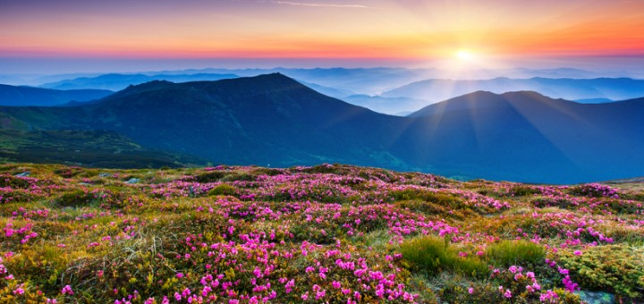
Luke 17:26-30 “When the Son of Man returns, it will be like it was in Noah’s day. In those days, the people enjoyed banquets and parties and weddings right up to the time Noah entered his boat and the flood came and destroyed them all. “And the world will be as it was in the days of Lot. People went about their daily business—eating and drinking, buying and selling, farming and building— until the morning Lot left Sodom. Then fire and burning sulfur rained down from heaven and destroyed them all. Yes, it will be ‘business as usual’ right up to the day when the Son of Man is revealed.

